Slide 1
Using Github

Slide 2
Git vs Github
Github is a repository of files (think dropbox or google docs)
Git is a version control system and looks at who has changed files when and if there are conflicts
Github repositories (repos) are formed by either forking another repo or creating one from scratch

Slide 3
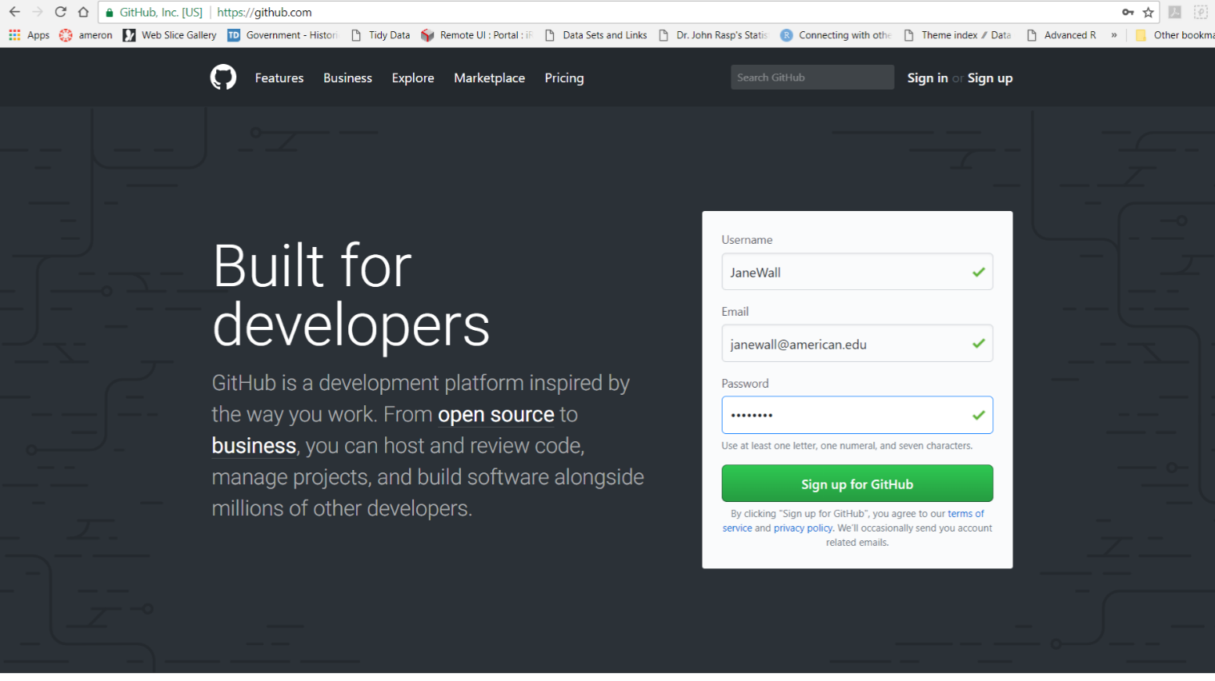
Creating a Github repo from scratch
First, create a github account
Go to www.github.com and sign up for an account

Slide 4
We will now work through the Guide
Repo organizes a single project and can include your R markdown files, folders, datasets, spreadsheets, images, videos, etc.
Each repo should include a README file with info about the project
We will create a repo called Data Science Class Project (or you can name it something different if you want to). You might want to store your project here – then potential employers can see what you have done

Slide 5
Add a new repo
Upper right corner, click the + and select New repository
Name your repo
Write a short description
Initialize this repository with a README

Slide 6
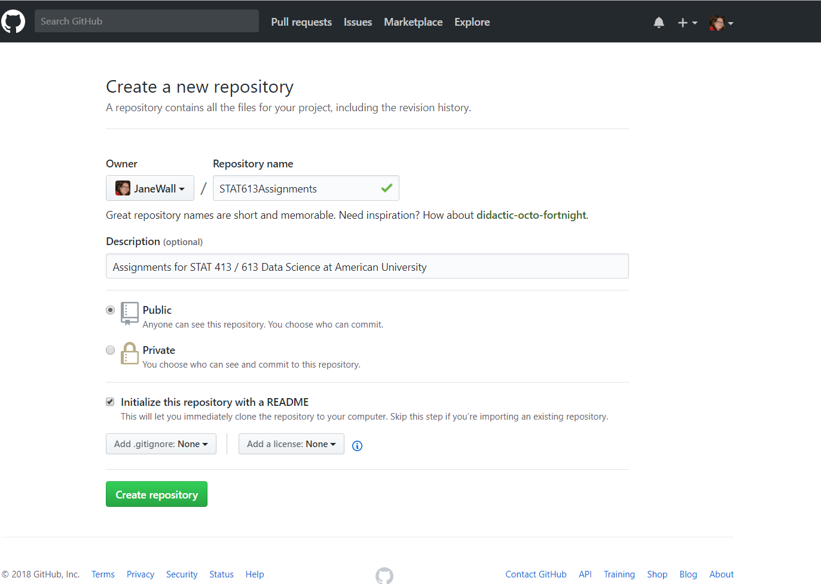

Slide 7
Modify the README
Click Create Repository
Then click the edit button on the README and add a better description to your file
Commit the change

Slide 8
Branches
There is always a master branch
A branch off the master makes a copy of the master for you to modify
Make changes to the branch
Submit pull request
When accepted, the changes get merged into the master branch
Click the drop down where it says branch:master
Enter a branch name
Click Create branch box

Slide 9
How to integrate changes to the Master
Make some sort of change to the branch (maybe upload a file or change the README)
Click commit change after putting a description of the change into the comments
This change is now only in the branch
Open a pull request to get it into the master – particularly useful when collaborating with others

Slide 10
Pull Request
Click the pull request tab
Enter a description of the changes you made
Submit the pull request
As the owner of the master, you will now decide whether or not to accept those changes and merge into the master
Once merged, the master and branch will be the same
You can then delete the branch if you want to.

